Slide 1


CAPSTONE PROJECT
Billing And Premium Payment Portal
SHIVA PRASAD P
Simple Solutions!

Slide 2
Project Overview
The purpose of the Billing & Premium Payment Portal project is to provide a secure, user-friendly online system that enables insurance members to view, manage, and pay their monthly premiums conveniently and safely. This portal is designed to streamline the entire premium payment process, support auto-pay features and payment history, and integrate with major payment gateways like Razorpay for secure transactions.
The portal automates reminders for payments, invoices, auto-pay changes, and policy expiries via email/SMS, ensuring members never miss due dates. It offers real-time access to payment and invoice histories, supports multiple payment options (including cash), and lets users manage preferences easily.
Simple Solutions!

Slide 3
Actors & Their Roles
Customer Functions:
Secure login and profile management.
Online viewing invoices.
Making one-time premium payments via integrated gateways (Razorpay).
Setting up, enabling, and disabling automated (“auto-pay”) premium payments.
Accessing comprehensive payment history.
Receiving automated payment reminders(mail and sms).
Receiving automated Invoice reminders(mail).
Receiving automated Autopay reminders.
Insurer Functions :
Assign Invoices
Payment History
Invoice History
Manage Remainders(Send policy expiry mails)
Pay by cash
Simple Solutions!

Slide 4
Key Functionalities
Multiple Premium Payment Methods
The portal supports instant one-time payments through integrated gateways (Razorpay/PayPal) and manual payments (cash), providing flexibility and convenience.
Access to Comprehensive Payment History
Complete history of all premium payments is available for review, with downloadable receipts and clear tracking of payment status.
​
Reminders for Payments and Invoices
Email and SMS notifications are sent automatically for upcoming premium due dates, invoice generation, payment receival, and policy renewal needs.
Auto-Pay Setup and Management
Users can enable, manage, or disable automated recurring premium payments, reducing missed payments and ensuring consistent coverage.
Invoice Viewing
Members can view their current and past premium invoices, including detailed billing breakdowns for each insurance policy.
Simple Solutions!

Slide 5
System Architecture
Database (MongoDB): Stores all payments, insurers, customers, invoices, policies, tax rates.
Backend (Spring Boot Microservices):
REST APIs to manage data.
Frontend (React + MUI):
Responsive user interface for assigning invoices, Paying invoices,
Customer and Insurer dashboards for management tasks.
Simple Solutions!

Slide 6
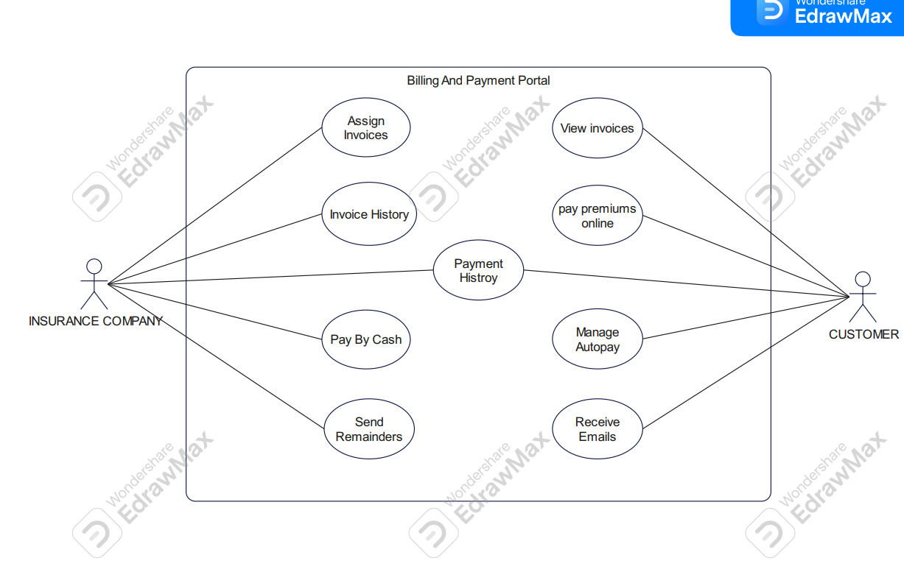
Use Case Diagram
Simple Solutions!

Slide 7
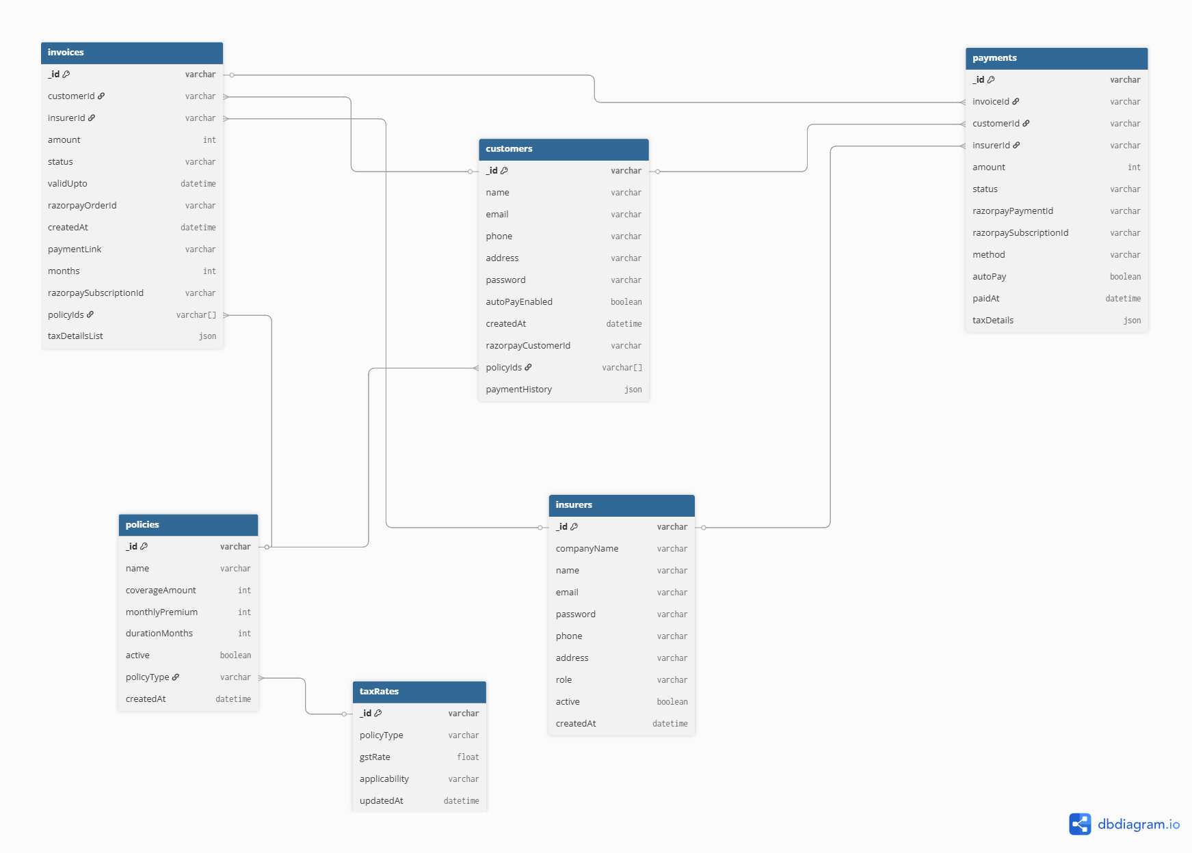
DB Diagram
Simple Solutions!

Slide 8
Documents
SRS
HLD
LLD
QSC
TestReports
Simple Solutions!

Slide 9

Q/A
Simple Solutions!

Slide 10
Thank You
Simple Solutions!

